Slide 1
Team Are We There Yet
Design Presentation

Slide 2
Introduction
Project Mission
Play the game “Simon” for 15 seconds
Pick up a playing card and carry it across the finish line
Twist one row of a Rubik’s cube 180 degrees
Draw “IEEE” on an Etch-A-Sketch
Line follow
Complete round in 5 minutes or less

Slide 3
Competition Course

Slide 4
Design Solution
Process

Slide 5
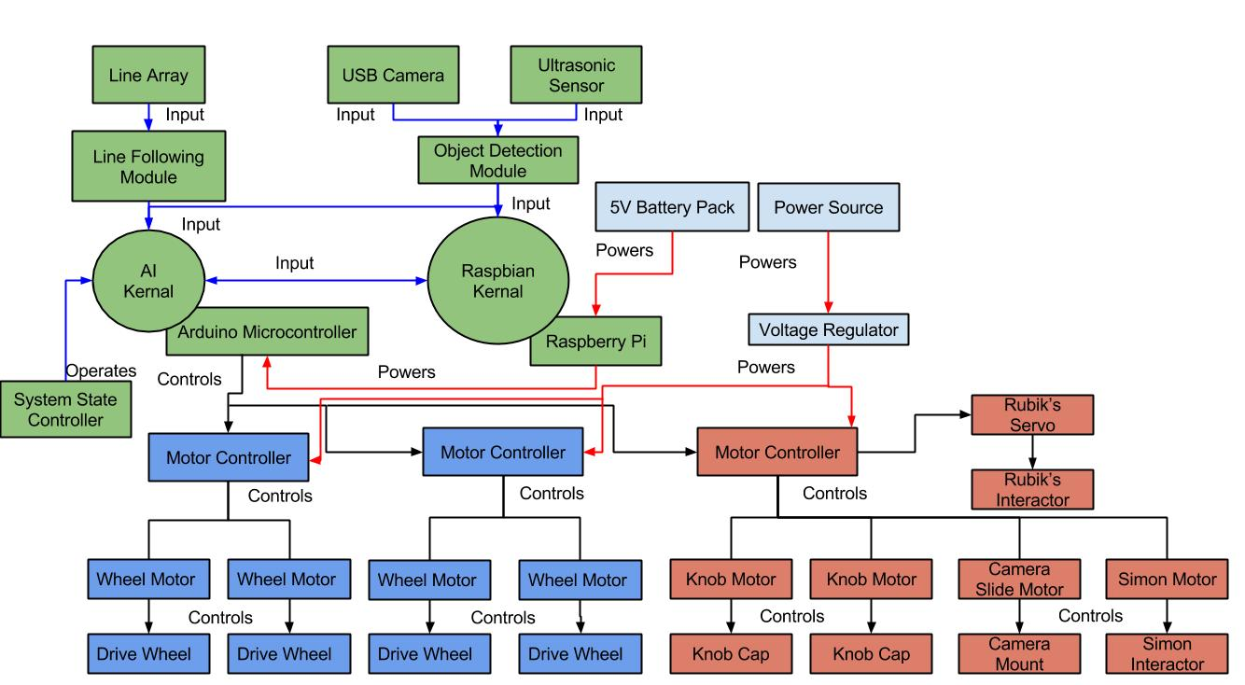
System Architecture

Slide 6
Design Considerations
Assumptions and dependencies
A
A
General Constraints
A
A
Safety Constraints and Considerations
A
A

Slide 7
Subsystems
Coordination Subsystem
Blurb
Movement Subsystem
Blurb
Challenge Subsystem
Blurb

Slide 8
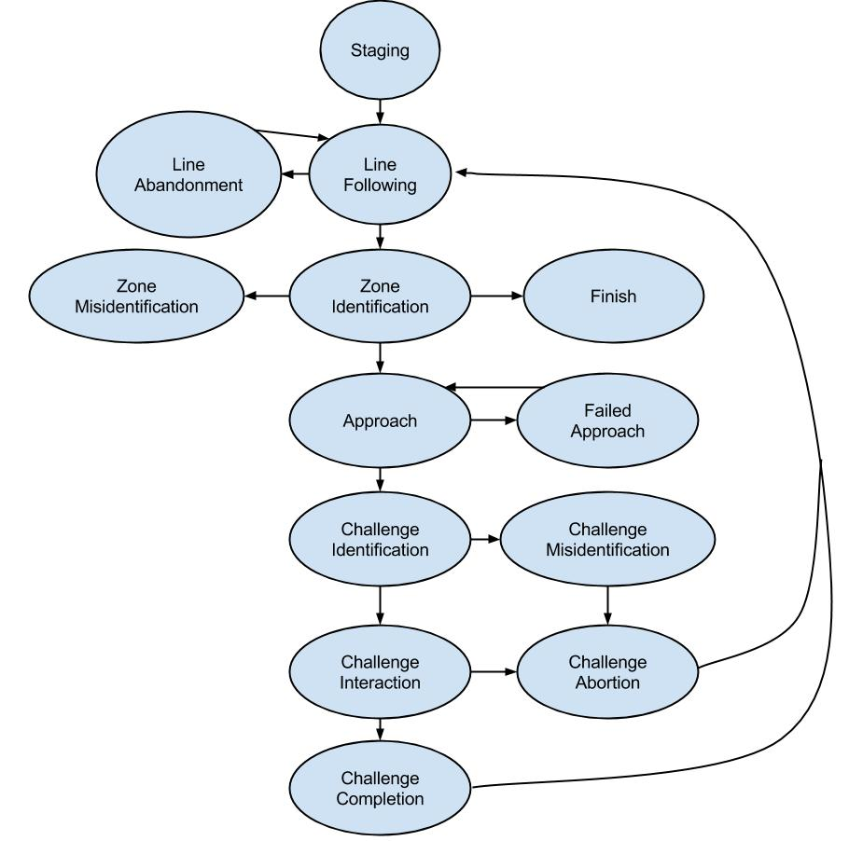
Coordination Subsystem
Purpose and responsibilities
Constraints

Slide 9
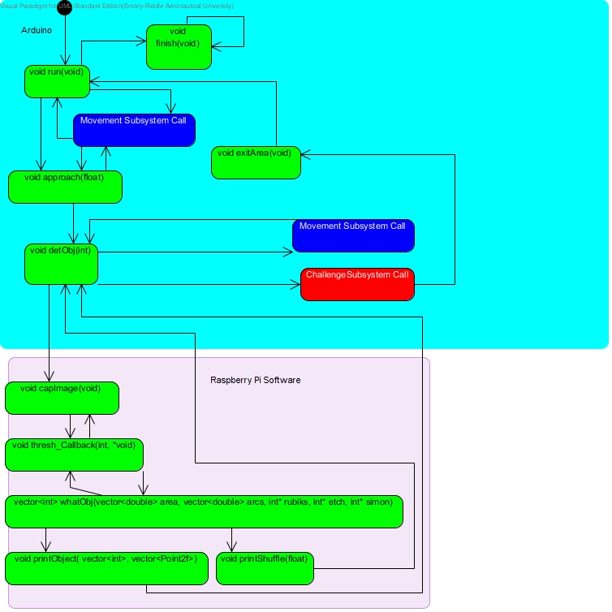
Functional Diagram

Slide 10
Parts List
Raspberry Pi B+
Arduino Mega 2560
IR Line Sensors
USB Camera
Ultrasonic Sensor

Slide 11
Movement Subsystem
Purpose and Responsibility
Performs all movement operations
Motors and wheels
Chassis
Constraints
Fit within starting area
Maintain contact with course floor

Slide 12
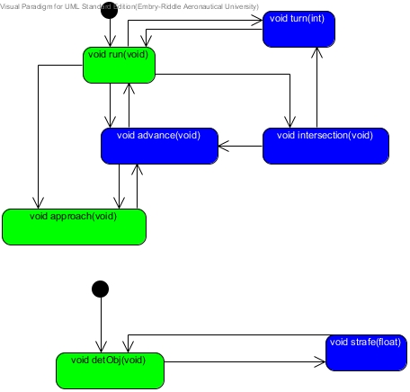
Functional Diagram

Slide 13
Parts List

Slide 14
Chassis
2 tiers
(weight)
(dimensions)

Slide 15
Motors
Motor stuff

Slide 16
Wheels
Wheel stuff

Slide 17
Battery
Battery stuff

Slide 18
Challenge Subsystem

Slide 19
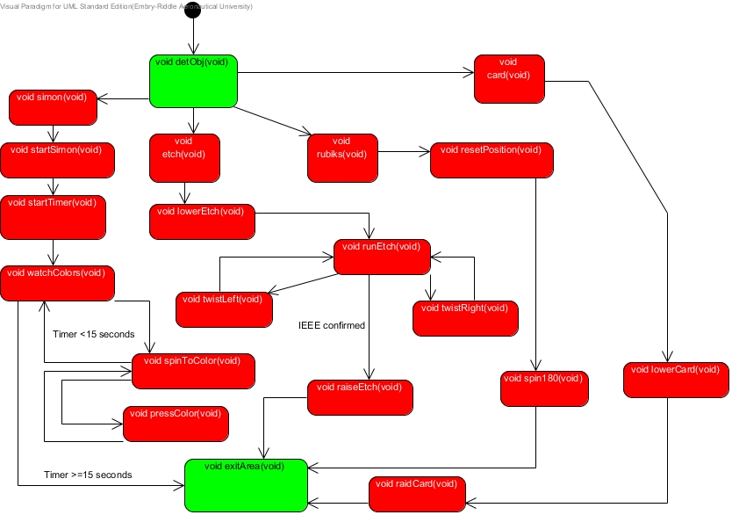
Functional Diagram

Slide 20
Parts List

Slide 21
Simon Interactor
Information about interactor

Slide 22
Rubik’s Cube and Card Interactor
Information about interactor

Slide 23
Etch-A-Sketch Interactor
Information about interactor

Slide 24
Video of Performance

Slide 25
Semester Re-cap
Accomplishments
Goals for next semester

